Slide 1

supermarket online
Document part

Slide 2
content
(use case - use case scenario - context level - data flow levels ( with declaring physical and logical) - ER - data dictionary - interview question – questioner form - and other methods you used to gather related information about system )

Slide 3
context level
customer
CustName ,contact
Custname, address
Customer
Data base
contact
Product barcode
And payment
Supermarket system
Customer id
Product
Data store
Get barcode
get receipt
product id and price
Product qoauntity
purchase data store
Cust id, product id and price
receipt

Slide 4
Logical data flow digram
customer
customer
D1
price
price
receipt
payment
1
Look up
price
3
Calculat
Amount to be paid
Identify items
2
Compute total cost
Collect money and give receipt
4
Items id
Items ,price

Slide 5
Physical data flow diagram
customer
customer
UPC price
D2
D1
Temporary trans.file
Items desc.
And
price
Items , price and subtotl
Items brought to checkout
CPU code
Item and price
cash check
Cash
Register
receipt
1
Look up code and price
Compute total cost
Collect money and give receipt
2
3
Calculat
Amount to be paid
4
Pass item over scanner
UPC BAR code
Item code

Slide 6
Use case
client
registration
customer
search
select
system
accept
Check price,id
payment

Slide 7
use case scenario
Use case :1 use case name: create account actors: manager, customer priority: high TYPE: external. Trigger : user selects the “crate account user" link. Description: the create account use case allow manager and customer to create their accounts and become a registered member. Preconditions: none Normal course: 1.The customer enter the full name, email address and password. 2.The manager enter the full name, email address, password and name 3.The system will ask them to choose strong password. 4.The system will ask to reenter the password. 5.The account will be created after click on sign up button.

Slide 8
Alternative courses: 1-invalid entry of information -the system will show the message to reenter the valid data. 2-weak password -the system will show the message to enter strong password. 3-password not match -the system will show the message to reenter the password. Post conditions: 1.The manager and customer are now member. 2.The system display all features to which customer and manager are associated with as defined in their account.

Slide 9
Use case :2 use case name: register actors: manager, customer priority: high type: external. Trigger : user selects the “loge in" link. Description: this use case allow manager and customer (members)to loge in system for choose supermarket and product. Preconditions: customers and managers should be members. Normal course: 1.The customer email address and password. 2.The manager enter email address, password and name of the supermarket.

Slide 10
Alternative courses: 1- customers and managers should not be members. 2-customer and manager enter a wrong password or email. Post conditions: 1.The manager and customer are registering into system.

Slide 11
Use case :3 use case name: search actors: customer priority: high type: external. Description: this use case allow customer to search and choose for product. Trigger : searching for favorite product and selecting favorite supermarket. Preconditions: 1.The customer should be registered. Normal course: 1.Search bar appear on homepage. Alternative courses:
No supermarket available
2.The system display the message sorry no supermarket available in that area. Post conditions: 1.The system display the supermarket that customer searched.
2.The system does not display the nearby restaurant incase searched supermarket not available.

Slide 12
Use case :4 use case name: select actors: customer priority: high type: external. Trigger : searching and selecting meal. Description: this use case allow customer to check the menu of supermarket. Preconditions: 1.The customer should be registered. 2.The customer should search for supermarket Normal course: 1.The customer search for supermarket 2.The system displays the supermarket section. 3.The check menu button appear at top of supermarket section.

Slide 13
Alternative courses: No product available 2.The system display the message sorry no product in that menu. Post conditions: 1.The system display meal that customer searched. 2.The system does not display meal incase searched meal not available in menu.

Slide 14
Use case: 5 Use case name: payment. Priority: high Actor: customer Description: A process in which the customer choose how to pay for supermarket. Trigger: Pay to supermarket. Type: external. Pre-condition: If payment is cash ,customer will pays after he will take meal. If payment is credit card ,customer will pays before he will make order. Normal case: Customer will determine how he will pay for supermarket Post condition: -If customer payed cash , delivery will get it. -If customer will pay credit card , system will send massage with confirmation payment. Alternative course: Customer does not have the money in cash :- -pay money by credit card.

Slide 15
Feasibility study
Technical feasibility
Economic feasibility
Organizational feasibility

Slide 16
Technical feasibility
Familiarity with technology:
Our team has good experiences and sufficient knowledge to deal with technology and web application, and if they do not have sufficient experience in web application, we will give them sufficient training and courses on how to deal with web application.
compatibility:
The system integrate with servers (computers) and web application and GPS device and food inside the supermarket and
Project Size :
Medium project not have more risk (because it is easy to use because of the instructions on how to use it correctly and because it saves time and effort).
Familiarity with Application:
We should have aware of working process of communication with supermarket management system.

Slide 17
Economical feasibility
 | YEAR 0 | YEAR 1 | YEAR 2 | YEAR 3 | YEAR 4
Total benefits |  | 3000 | 2200 | 6000 | 11200
Total costs | 2080 | 1120 | 1800 | 3500 | 8500
Net benefits | 2080 | 1880 | 400 | 2500 | 2700
Cumulative Net Cash Flow | 2080 | 200 | 200 | 2700

Slide 18
B.E.P=YEARS NAGATIVE +(YEAR NET CASH – YEAR COMM)/YEAR COMM B.E.P=1+(400-200)/400=1.5 ROI=(TOTAL BENEFIT-TOTAL COST )/TOTAL COST ROI=(11200-8500)/8500 =31%

Slide 19
Organizational feasibility
From my point of view , the direction of organizational process, this project has low risk. The objective of the system, which is to increase income, easily dealing with the supermarket by online, facilitate payment methods (credit or cash).

Slide 20
interview question
Do you have any previous supermarket experience?
Do you prefer to work alone or as part of a team?
How did you hear about the position?
Why do you want to work here?
What are your leadership experiences?
Why did you choose this career
Tell me about a time you had to work under a lot of pressure. How did you handle it?
Do you want to work at team or alone?
What do you know about our company?
What motivates you?

Slide 21
questionnaire form
How many times have you bought our products?
Have you used any of our discounts and special offers?
How well do you evaluate the quality of our products?
What did you like most about our offers?
How fast is the service?
How satisfied are you with the online application experience on our site?
Do you find it difficult to access the product?
Are you taking a long time to get to your product?
How likely are you to visit our site again?
How likely is it that a supermarket recommends a friend or family member?

Slide 22
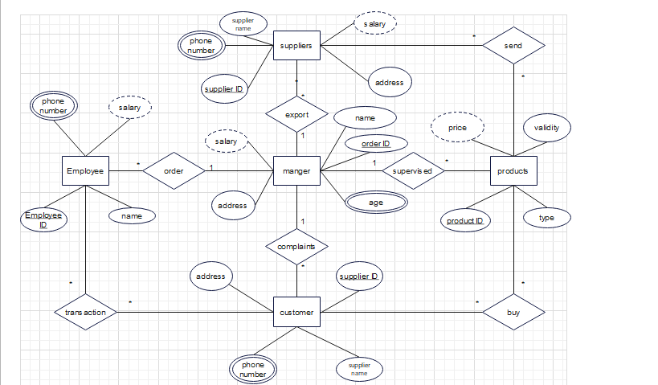
SuperMarket ERD :

Slide 23
This Slide Done By :
Hassan Barka
Omer Mohamed Abo Zied
DeskTop App With DataBase Done By :
Ahmed Abd Elrahman Shams

Slide 24
Members : 1- Hassan Barka 2-Ahmed Abd Elrahman Shams 3-Omer Mohamed Abo Zied

